Slide 1


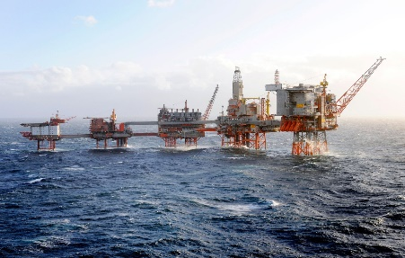
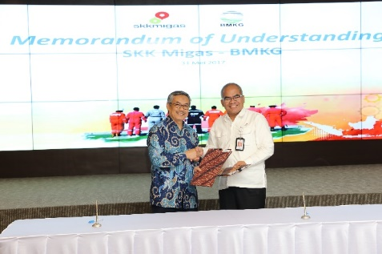
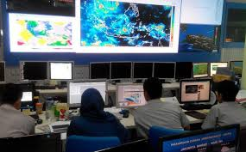
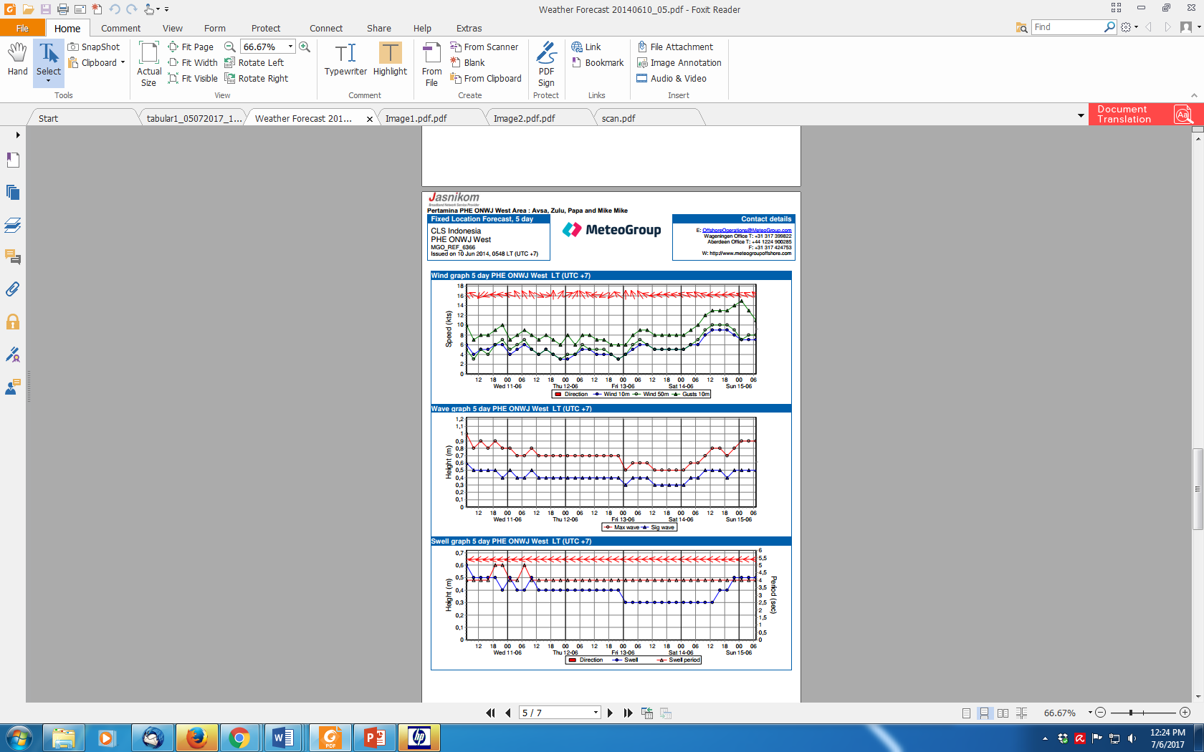
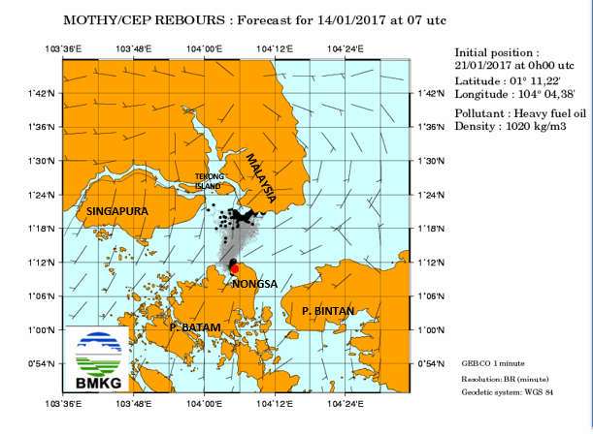
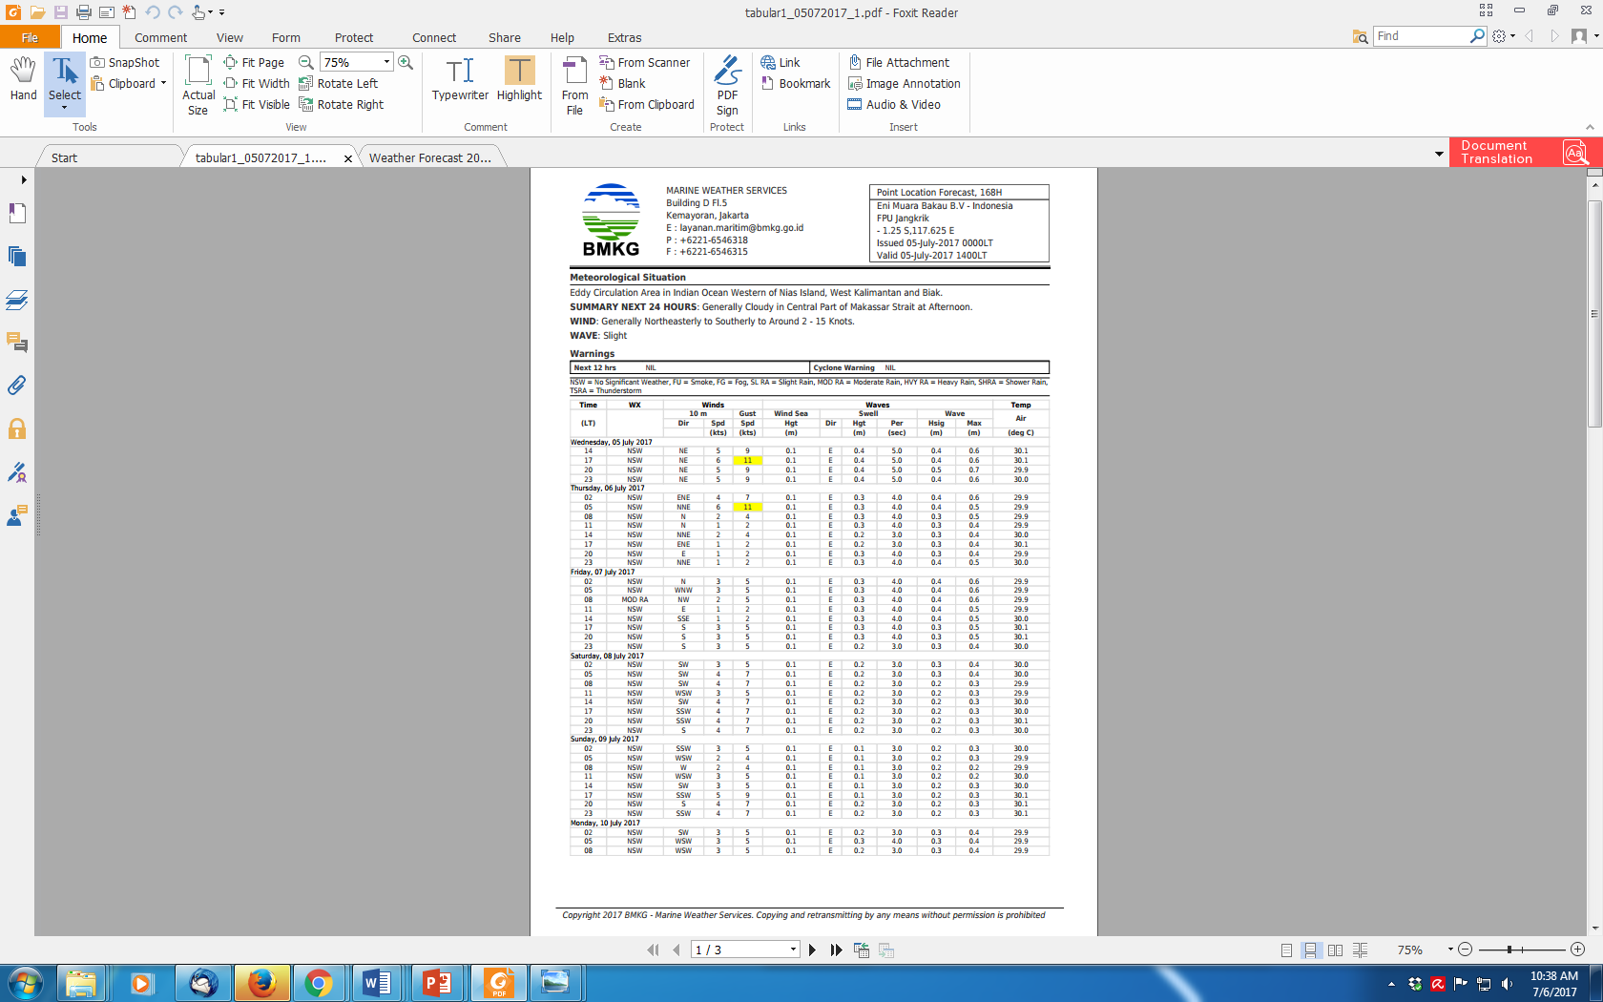
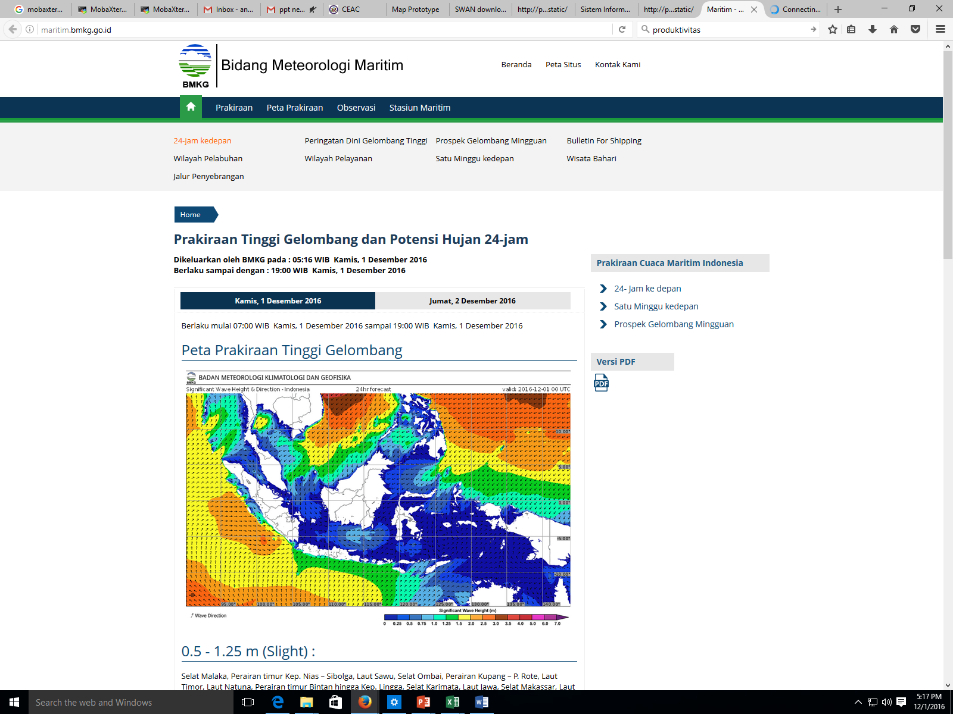
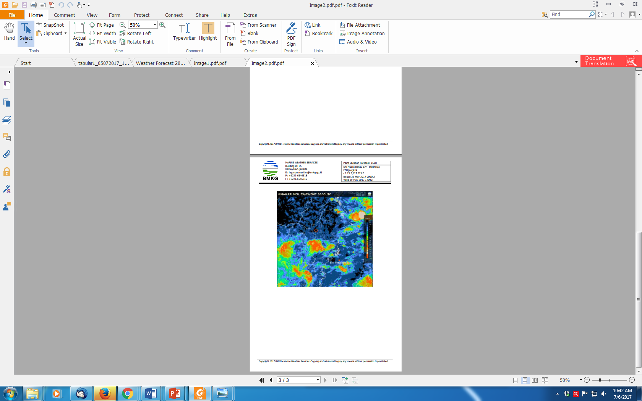
NWP MODEL VERIFICATION (Assessing the Accuracy of Numerical Weather Prediction Models)
WIDO HANGGORO

Slide 2

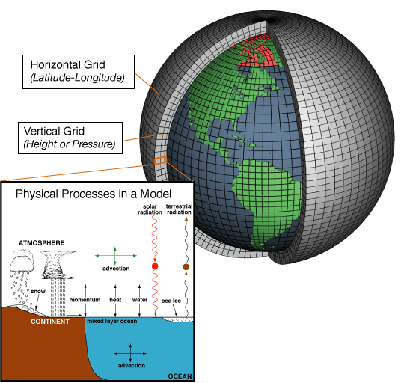
What is (Model) NWP?
Simplification
Numerical: using data or numbers; in reference to the methods used (i.e., the solving of mathematical equations).
Weather: the state of the atmosphere with respect to wind, temperature, moisture, pressure, etc.; also referring to the time scale (e.g., in contrast to climate).
Prediction: an act of declaration of a future event; more generally, a forecast of a past, present, or future event.

Slide 3
Take the equations of fluid mechanics and thermodynamics that describe atmospheric processes.
Convert them to a form where they can be programmed into a large computer.
Solve them so that this software representation of the atmosphere evolves within the computer.
This is called a “model” of the atmosphere

Slide 4
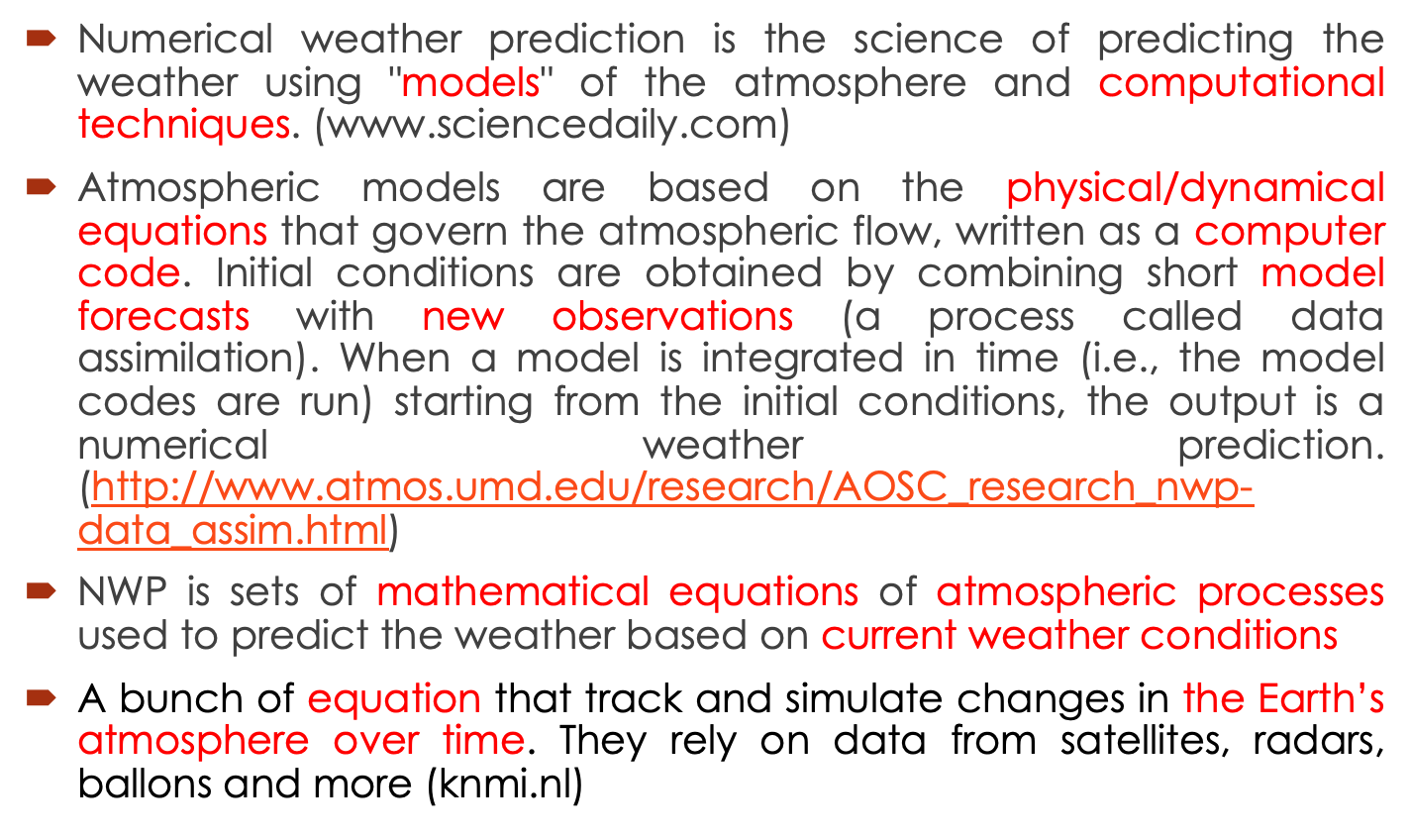
Definitions

Slide 5
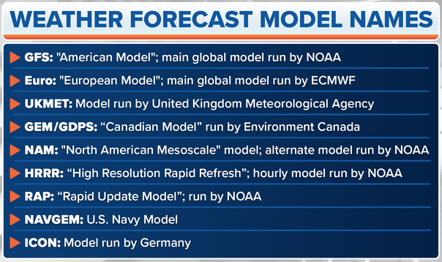

Slide 6
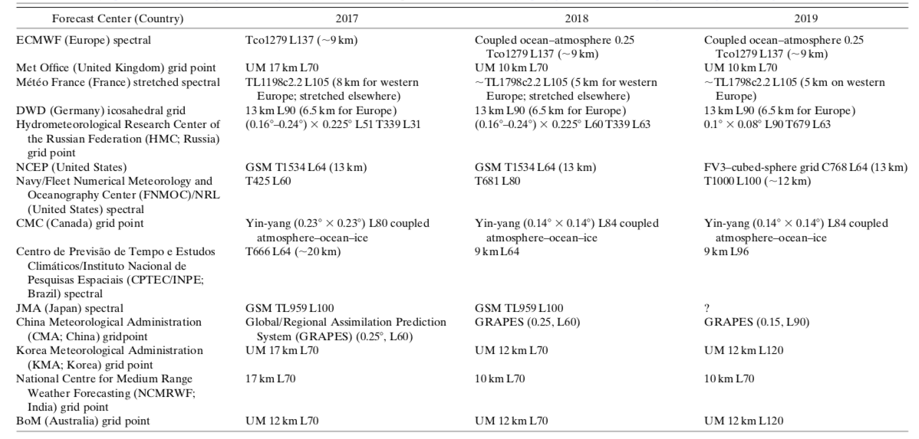

Slide 7
This eq. should be in the model
Conservation of momentum (Newton’s 2’d law)
3 equations for accelerations of 3-d wind (F = Ma)
Conservation of mass
1 equation for conservation of air (mass continuity)
1 equation for conservation of water
Conservation of energy
1 equation for the first law of thermodynamics
Relationship among p, V, and T
1 equation of state (ideal gas law)

Slide 8
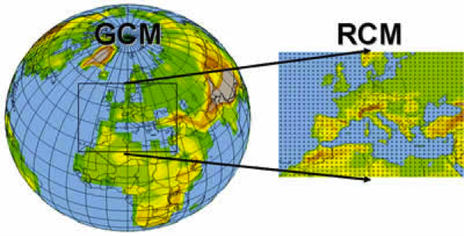
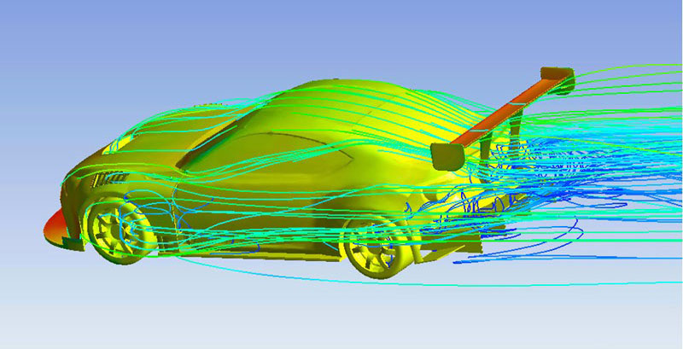
Model Scales
Global models - span the planet, represent large-scale atmospheric processes
Limited-area synoptic scale and mesoscale models – span continental, to state, to metro-areas; represent smaller-scale atmospheric processes
Computational fluid-dynamics (CFD) models – resolve flow around buildings, in street canyons, aircraft, etc.

Slide 9
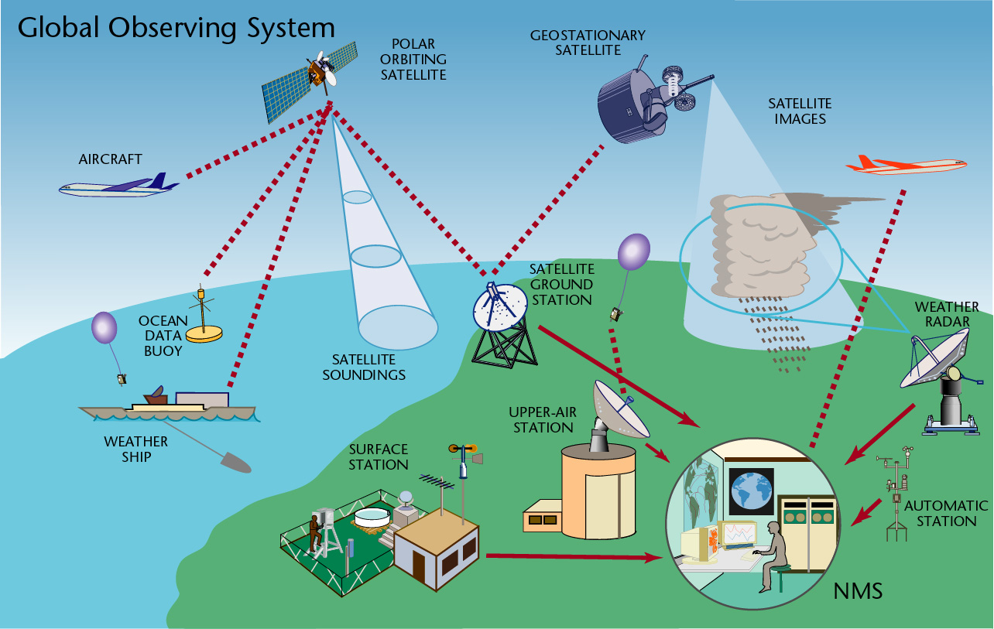
Model Inputs

Slide 10
NWP Strength’s
NWP objectively provide future information of atmospheric conditions through simulation dynamical, physical and radiative processes in the atmosphere
NWP models reflect our best understanding of the motions and processes in the atmosphere
Able to project weather variables over a wide area and for a long-range time lead
Can be coupled with another model (wave, air dispersion, wildfire etc)
Easy to access

Slide 11
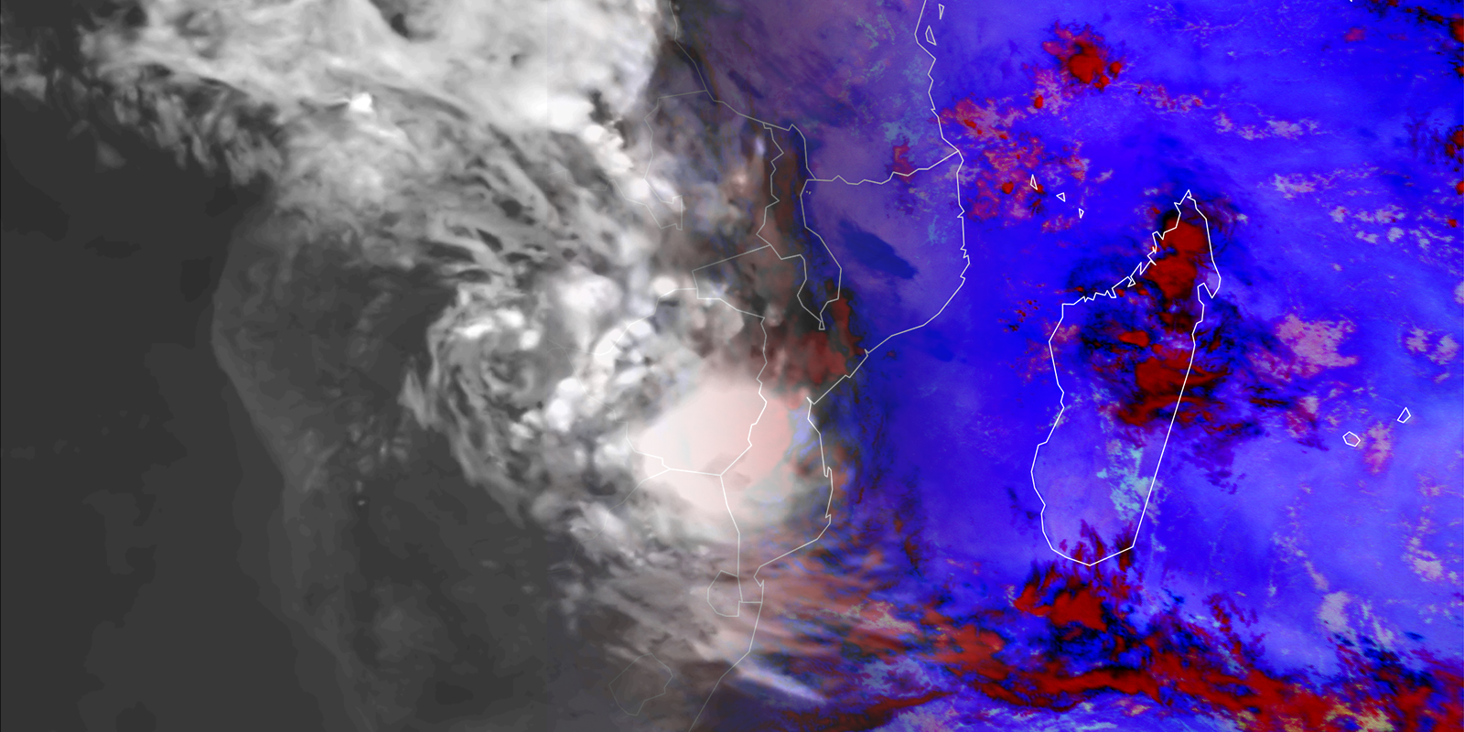
Is the Weather model Perfect?
Generally, global weather prediction models like the ECMWF and GFS are considered fairly accurate in predicting large-scale weather patterns and features. However, weather forecast accuracy can diminish over time as the forecast horizon extends.

Slide 12
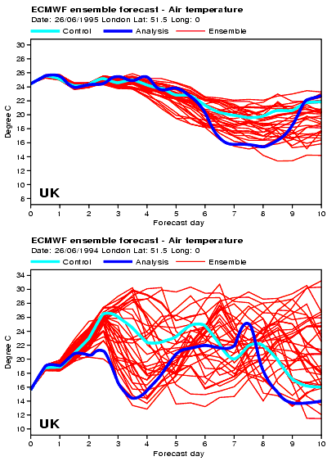
Example of error growth

Slide 13
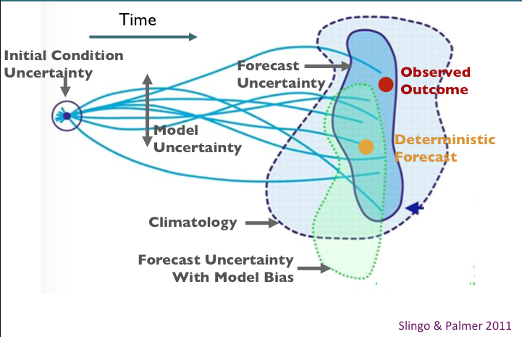
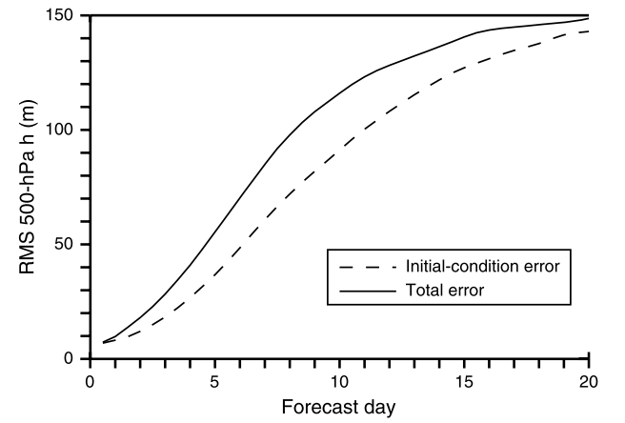
Model Limitations

Slide 14
Sources of Model error
Numeric
Physics (radiation, turbulence, moist processes)
Initial conditions - define the atmosphere’s current state…the starting point
Lateral boundary conditions - define the atmosphere’s state at domains’ edges
Lower boundary conditions – conditions at Earth’s surface

Slide 15
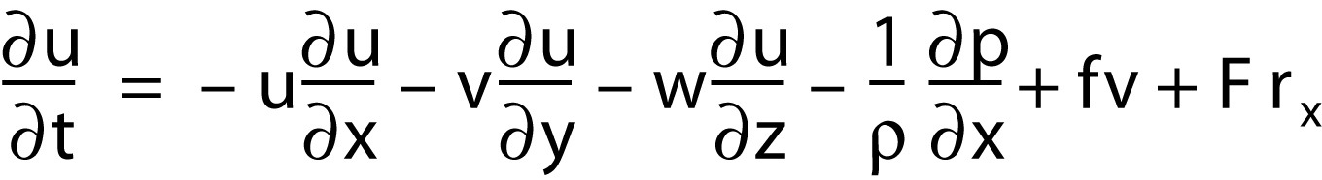

Differential Equation
An example differential equation – rate of change of the east-west component of the wind
u = east-west wind component, positive eastward
v = north-south wind component, positive northward
w = vertical wind component, positive upward
P = pressure
ρ = density
f = Coriolis parameter (2 x rotational frequency of Earth x sine of latitude)
F = frictional force in x direction

Slide 16
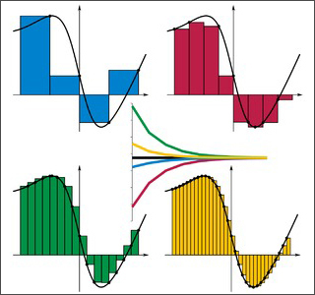
Problem Solving
The problem: computers can perform arithmetic but not calculus
The solution: numerical methods

Slide 17
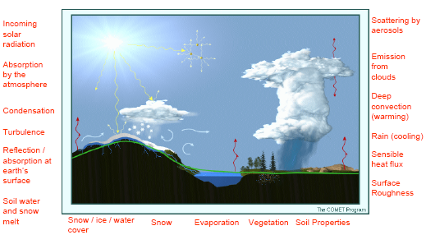
Parameterizations = approximate the bulk effects of physical processes that are too small, too complex, or too poorly understood to be explicitly represented

Slide 18
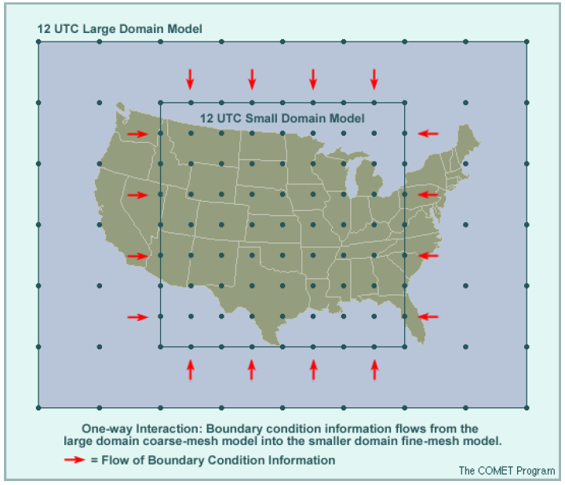
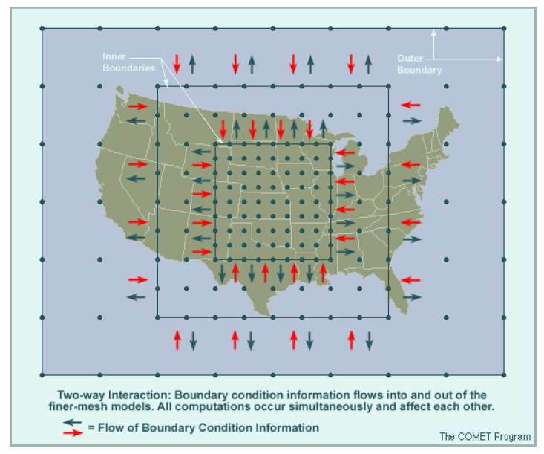
Lateral Boundaries

Slide 19
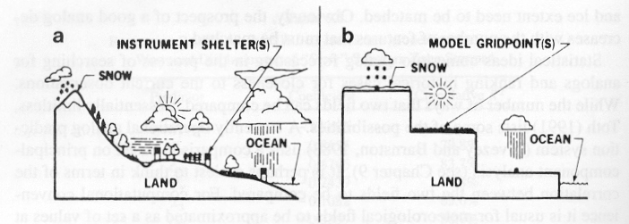
Lower Boundary

Slide 20
Success in NWP
the computer model be a realistic representation of the atmosphere
the initial conditions be known accurately
and the computing technology well support
Observation
NWP
Model
Computer

Slide 21
NWP Skill Improvement
the increased power of supercomputers, allowing much finer numerical resolution and fewer approximations in the operational atmospheric models;
the improved representation of small-scale physical processes (clouds, precipitation, turbulent transfers of heat, moisture, momentum, and radiation) within the models;
the use of more accurate methods of data assimilation, which result in improved initial conditions for the models; and
the increased availability of data, especially satellite and aircraft data over the oceans and the Southern Hemisphere.

Slide 22
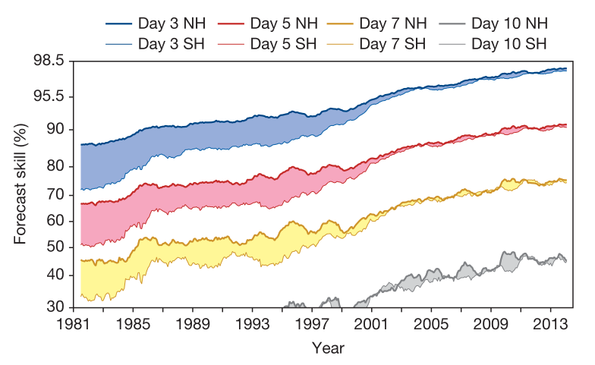

Slide 23
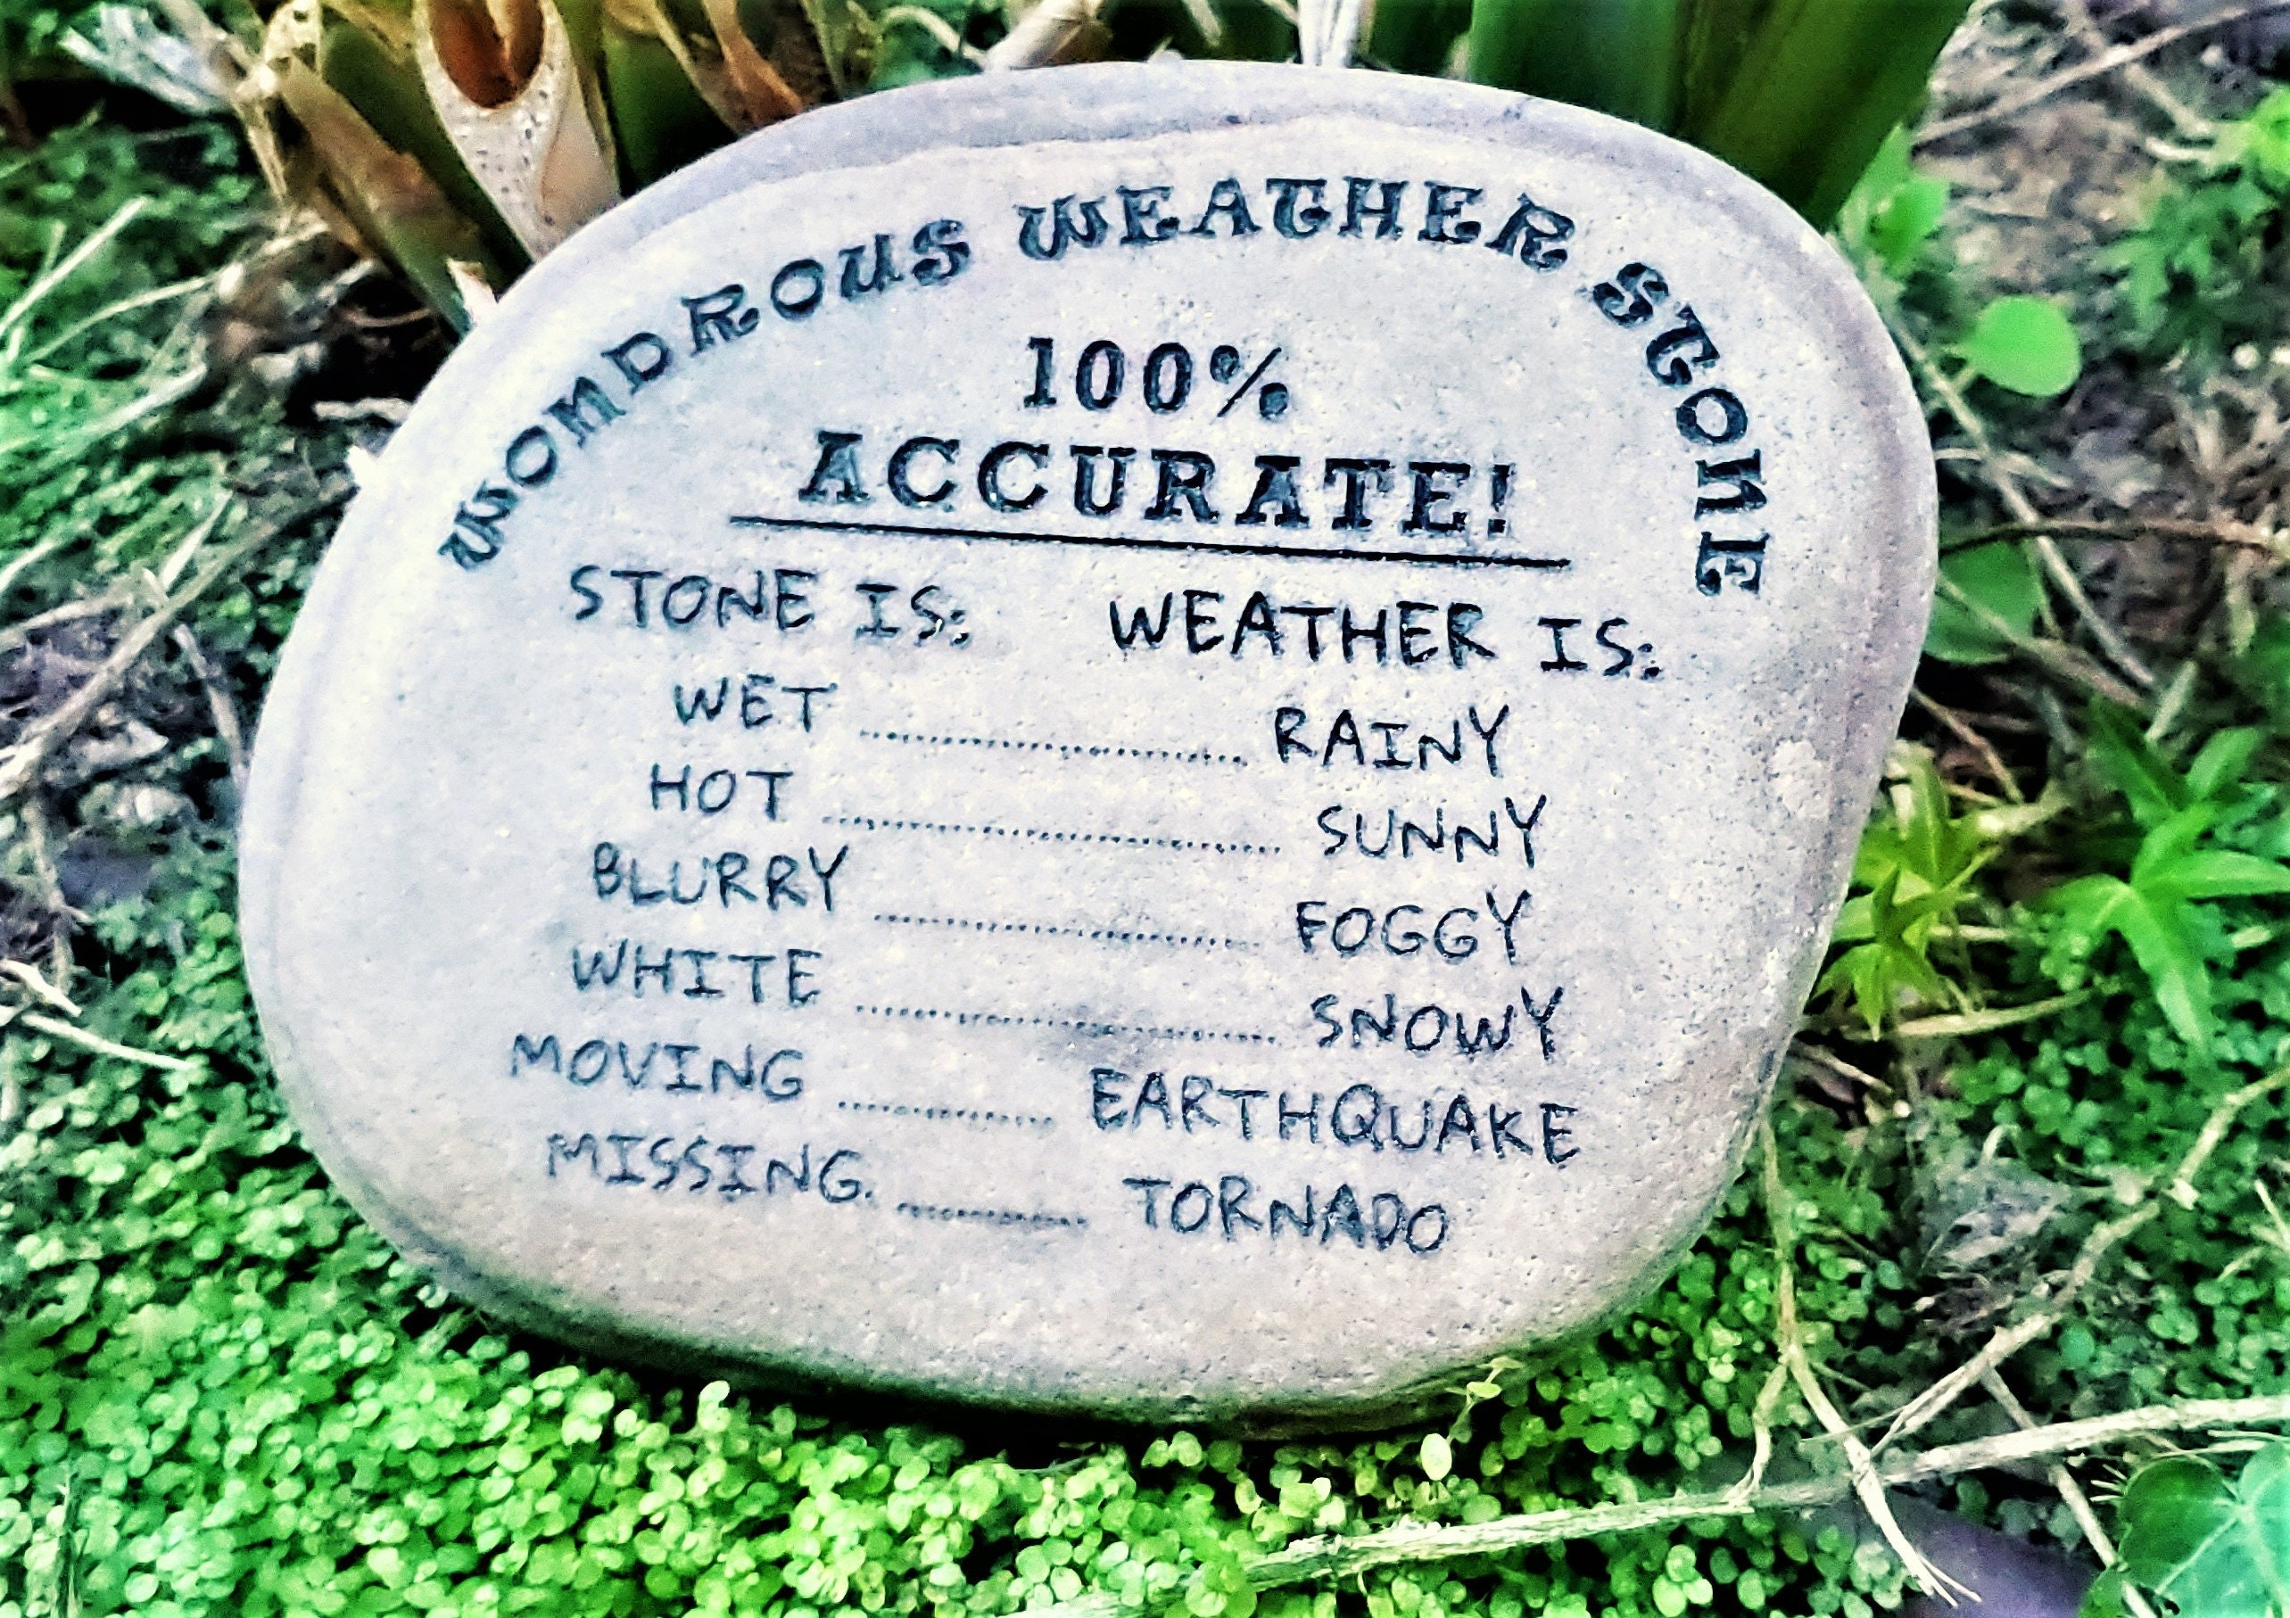
Verification
Process of evaluating a model’s performance by comparing its predictions to observations.

Slide 24
Purposes of Verification
Assess Performance: Measure the model’s ability to accurately simulate weather.
Identify Bias: Detect consistent over-predictions or under-predictions.
Improve Models: Feedback from verification allows model developers to improve their simulations.

Slide 25

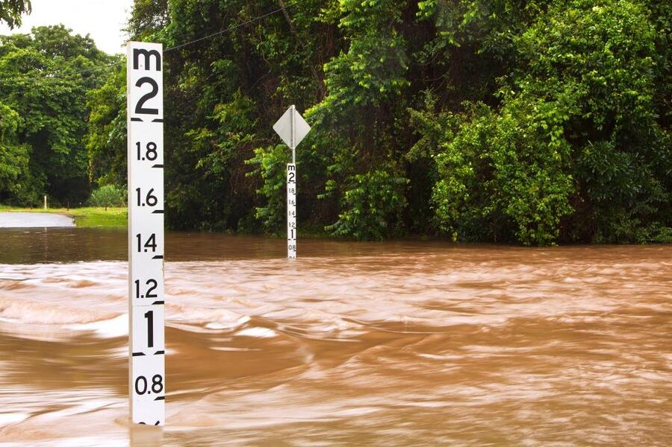
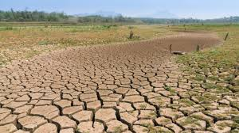

Why is So Important
Notes:
Accurate forecasts save lives during extreme weather events (hurricanes, floods).
Accurate short- and long-term predictions assist in resource planning for agriculture and energy sectors.

Slide 26
Verification Process
Data Collection -> for both forecast and observation data
Comparison -> Match the forecast to the observation in terms of time and location. Including interpolating model data to observation points
Scoring -> Apply statistical methods to calculate performance metrics (e.g., accuracy, bias).

Slide 27
Matching forecasts and observations…
Point-to-Grid
or
Grid-to-Point
Machu Picchu
10
Machu Picchu
10

Slide 28
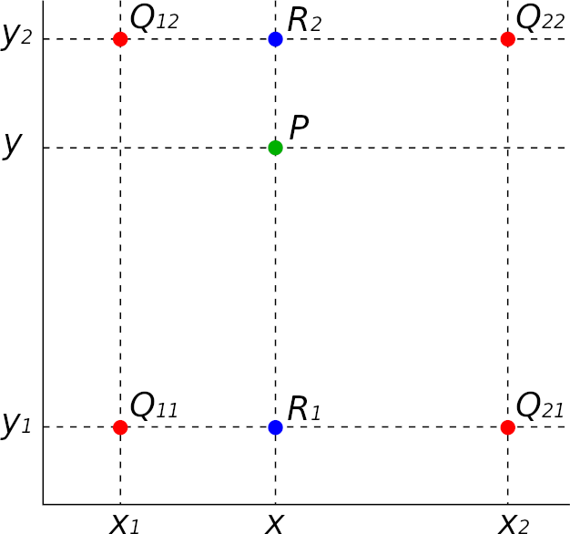
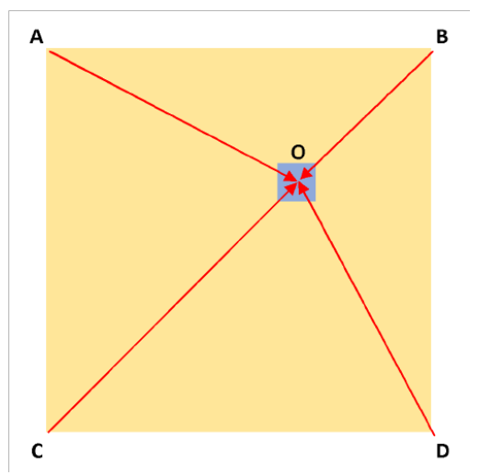
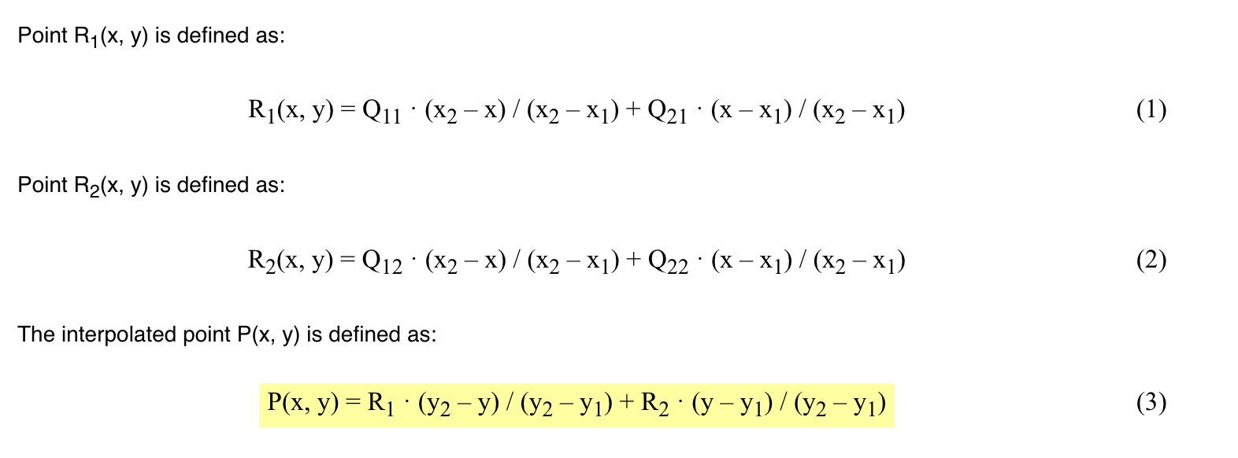
Bilinear

Slide 29
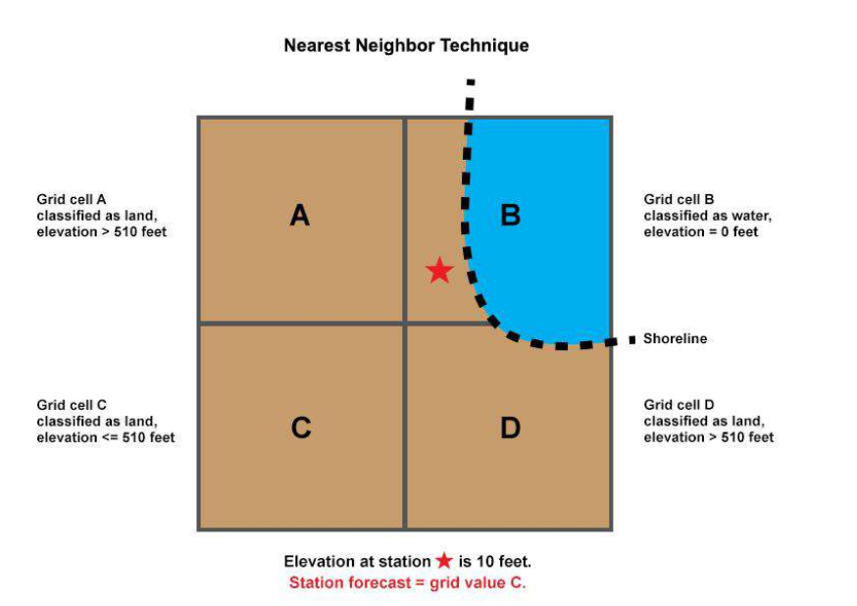
Nearest Neighborhood

Slide 30
Verification attributes (examples)
Measure different aspects of forecast quality
can be related to joint, conditional and marginal distributions of forecasts and observations
Bias
(Marginal distributions)
Correlation
Overall association (Joint distribution)
Accuracy
Error measure of differences (Joint distribution)
Calibration
Measures conditional bias (Conditional distributions)
Discrimination
Degree to which forecasts discriminate between different observations (Conditional distribution)

Slide 31
Further verification issues…
Forecasts must be formulated so that they are verifiable!
Corollary: All forecast should be verified ⬄
If something is worth forecasting ⬄ It is worth verifying
Stratification and aggregation
Aggregation can help increase sample sizes and statistical robustness but can also hide important aspects of performance
The most common regime may dominate results and mask variations in performance
Important to:
Stratify results into meaningful, homogeneous sub-samples!

Slide 32
Further verification issues…
Observations
No such thing as observed “truth”!
Observations generally are more “true” than the model analysis
⬄ Utmost care if using model analysis as verification “truth” since the analyses are model dependent!
⬄ Analyses can be used for comparison between versions of same model, e.g. operational vs. experimental suite
Observational uncertainty should be taken into account
E.g., how well do adjacent observations match each other?
Quality checking of observations
Removal of gross errors, instrument errors and reporting errors
Removal of biases

Slide 33
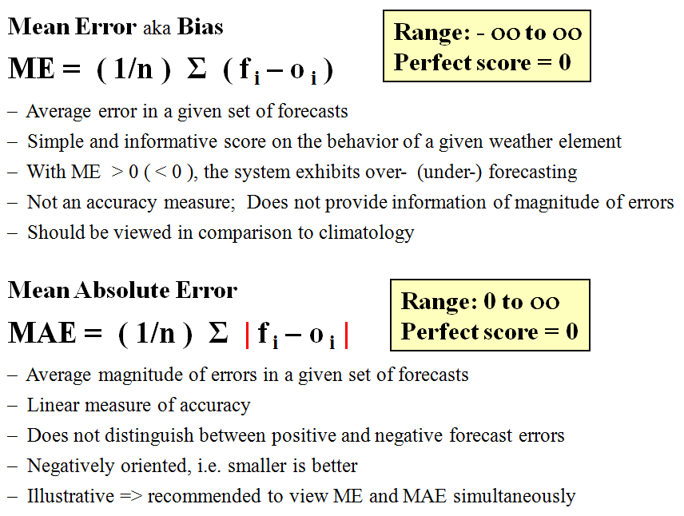
Verification Metrics
Continuous predictand
Attribute:
Bias
Attribute:
Accuracy

Slide 34
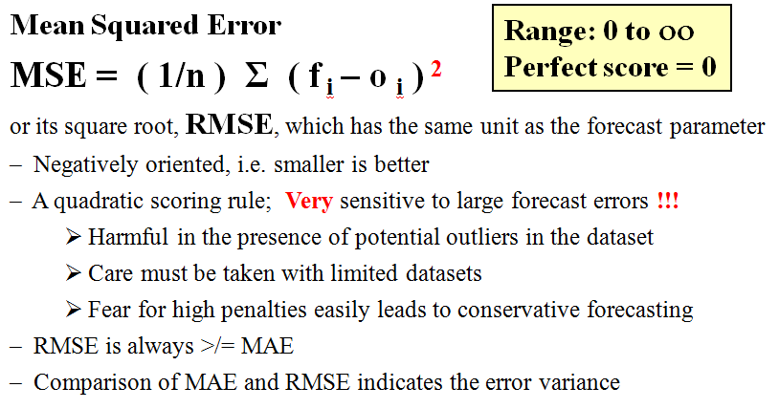
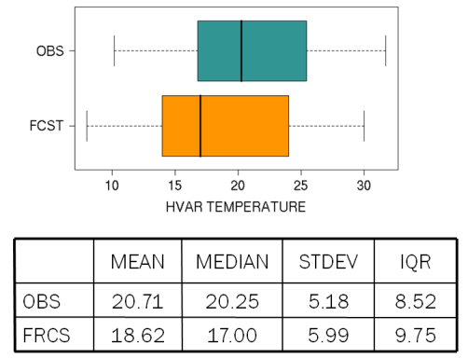
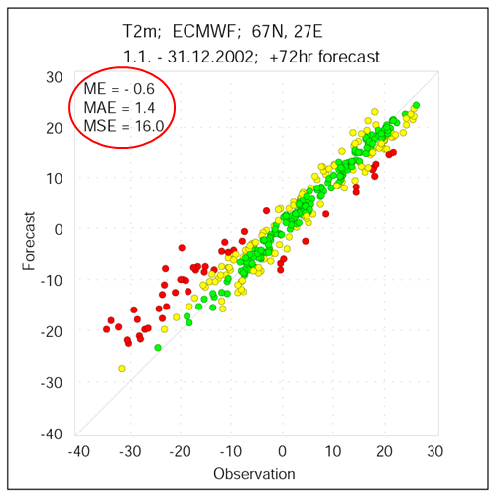
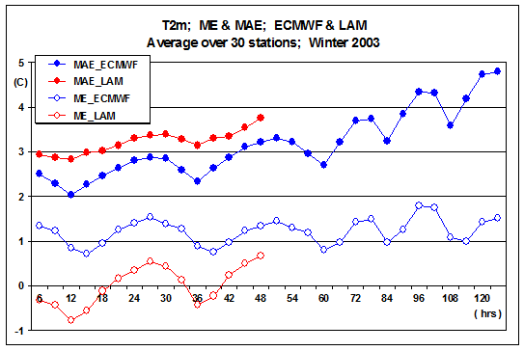
Attribute:
Accuracy
Explore the data

Slide 35
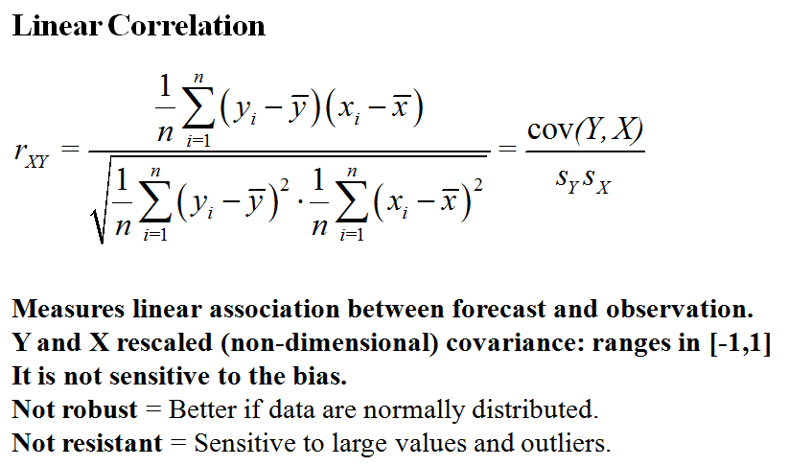
Attribute:
Association

Slide 36
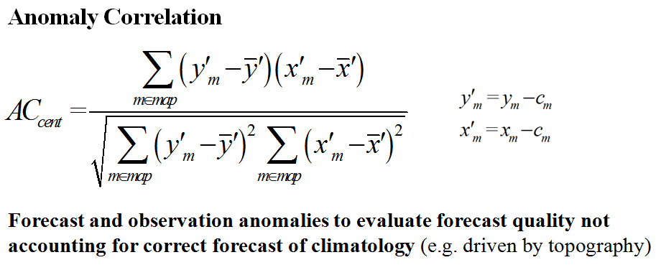
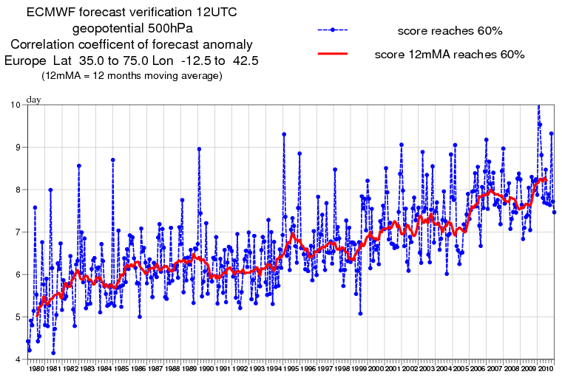
ACC
Attribute:
Association
ACC is the correlation between forecast and analyzed deviations from climatology, i.e. ACC can be regarded as a forecast skill with reference to the climate.
ACC ~ 60 % considered (by some)
as limit of useful NWP forecasts
(cf. picture right)

Slide 37
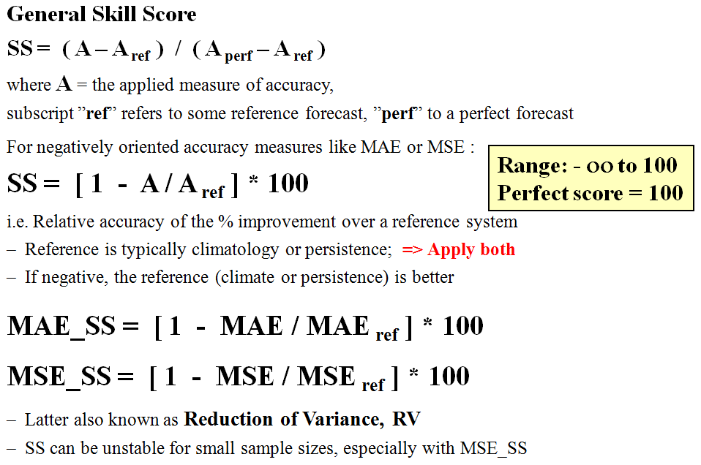
Attribute:
Skill

Slide 38
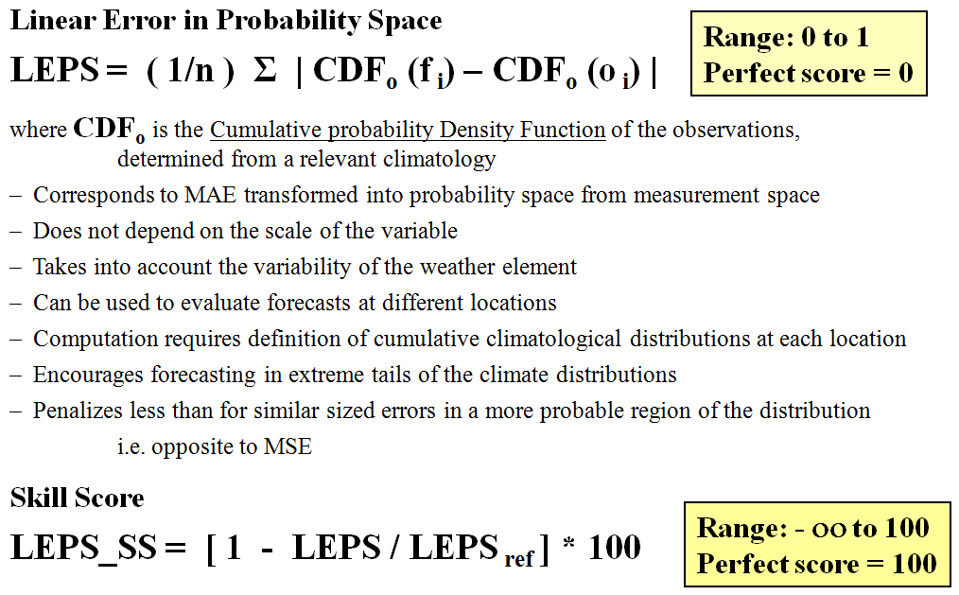
Attribute:
Accuracy

Slide 39
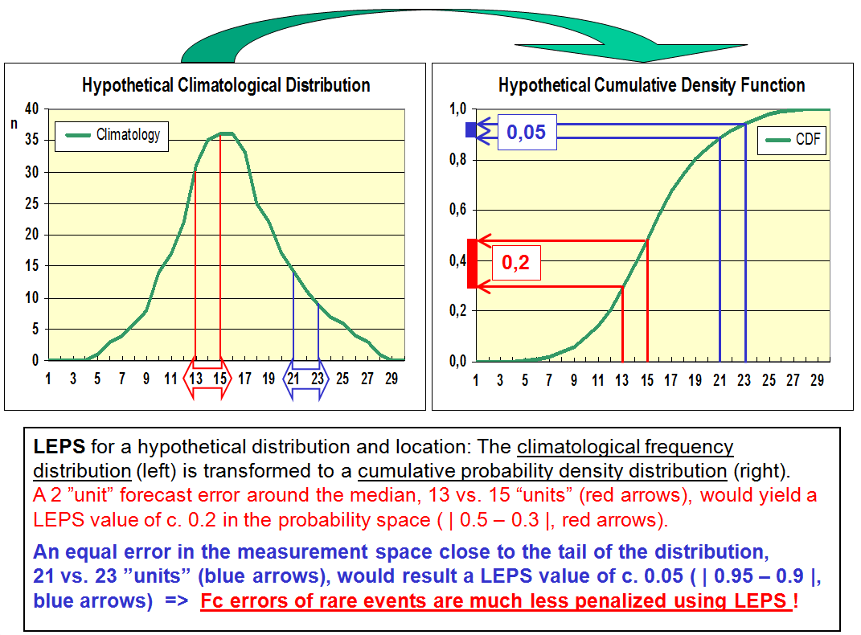

Slide 40
Continuous predictands - Summary
Verify a comprehensive set of weather elements
Explore data by scatterplots & time-series plots
”Stratify & Aggregate” + Compute ME, MAE, MAE_SS
Additionally, compute LEPS, LEPS_SS, MSE, MSE_SS
Examples:
Temperature: fixed time (e.g. noon, midnight), T_{min}, T_{max}, time-averaged
Wind speed and direction: fixed time, time-averaged
Accumulated precipitation: time-integrated (e.g. 6, 12, 24 hours)
Cloudiness: fixed time, time-averaged; However, typically categorized
500 hPa geopotential
Surface pressure

Slide 41
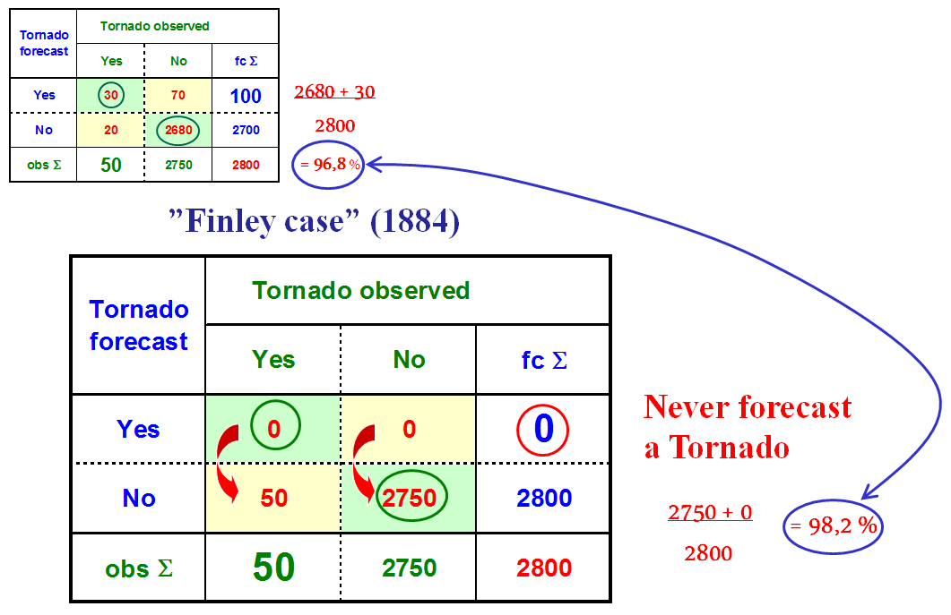
Categorical Predictand

Slide 42
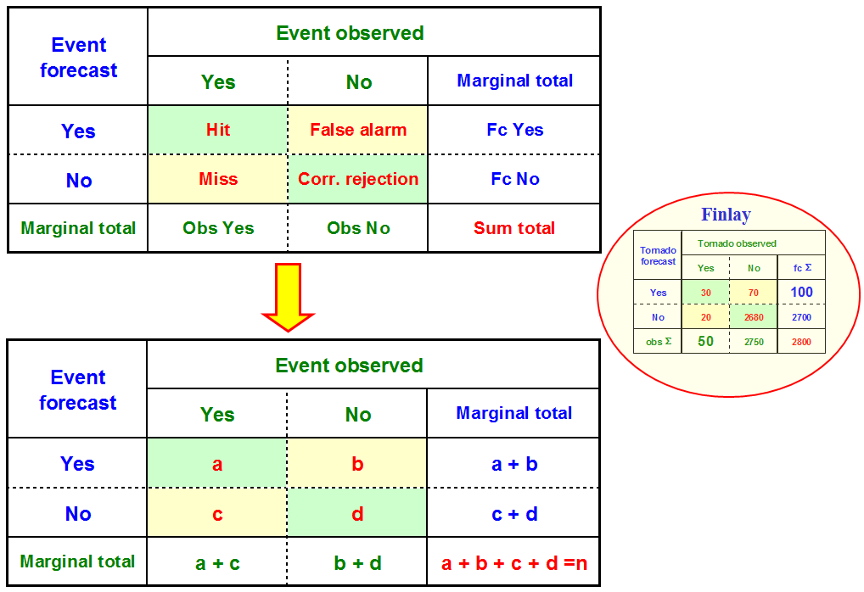
Finley

Slide 43
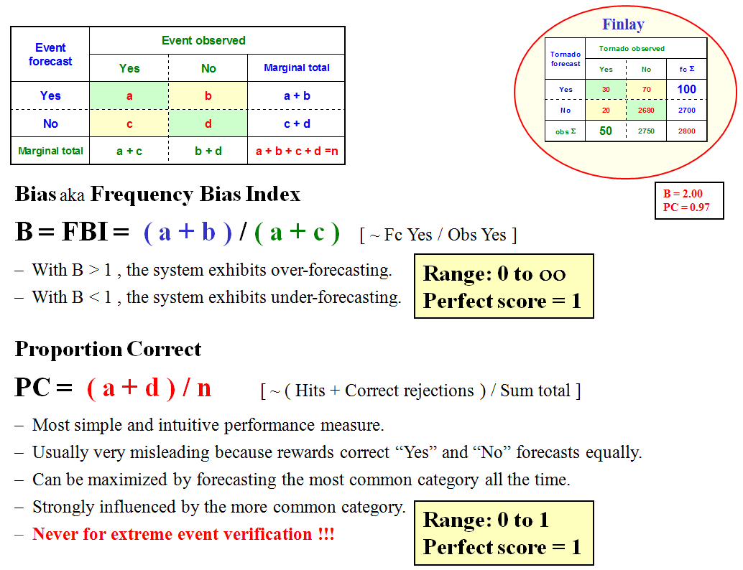
Finley

Slide 44
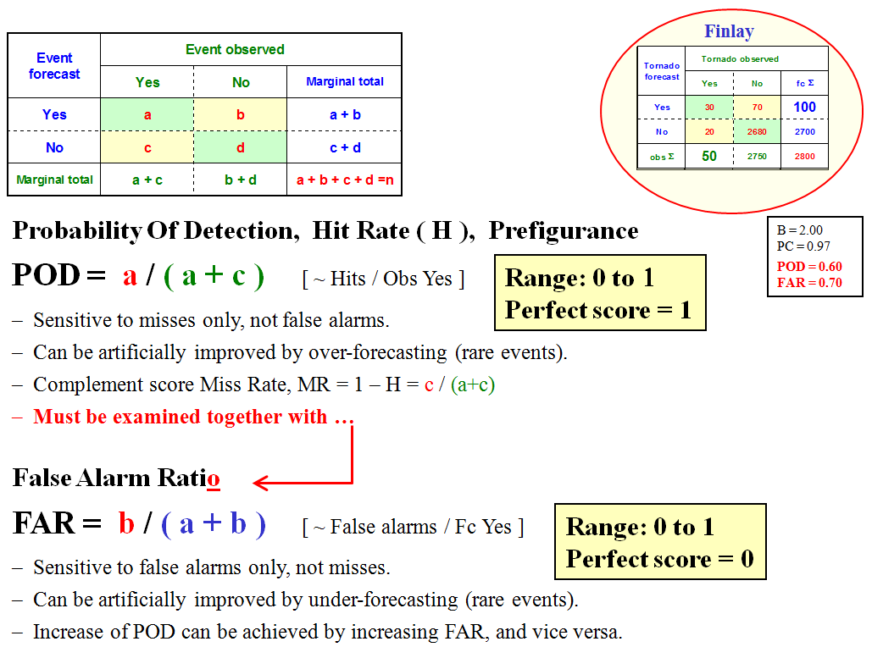
Finley

Slide 45
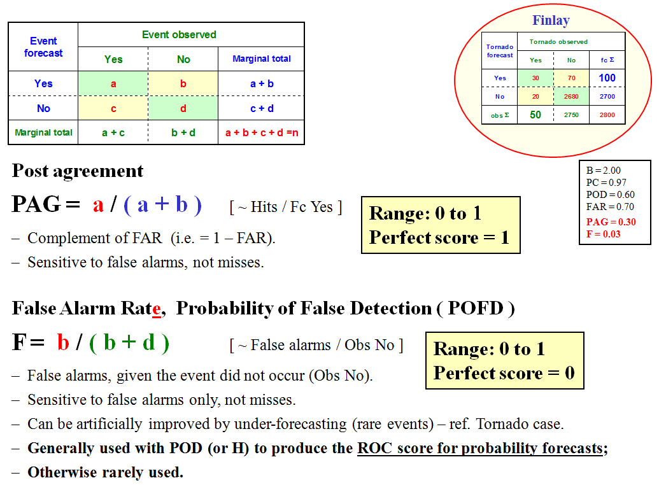
Finley

Slide 46
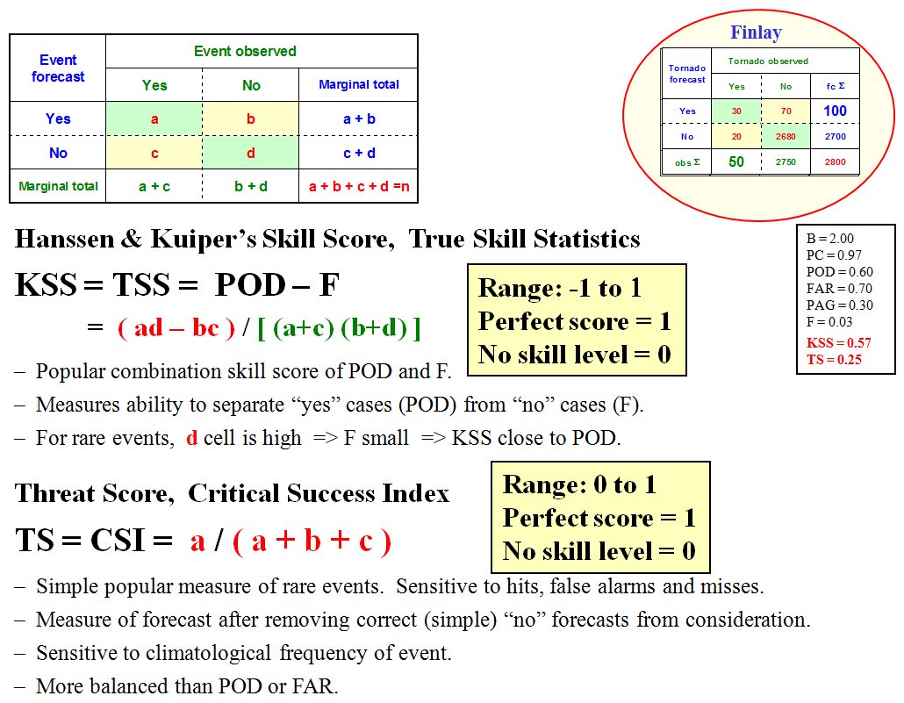
Finley

Slide 47

Finley

Slide 48

Finley

Slide 49


Slide 50


Slide 51


Slide 52

KSS,
KSS +42 hr
The ”traditional” scores tend to zero with the rarity of the event!

Slide 53
Categorical predictands - Summary
Verify a comprehensive set of categorical weather elements
Compile relevant contingency tables
Include multi-category events
Focus on adverse, extreme and/or high-impact events
”Stratify & Aggregate” + Compute B, POD & FAR, KSS, TS, ETS, HSS
Especially for rare events, compute SEDS, EDI (New scores!)
Examples:
Rain (vs. no rain); with various rainfall thresholds
Snowfall; with various thresholds
Strong winds (vs. no strong winds); with various wind force thresholds
Fog (vs. no fog)
Road surface friction below a critical level (e.g. 0.15)

Slide 54
Verification of Probabilistic
All forecasting involves some level of uncertainty
Deterministic forecasts cannot address the inherent uncertainty of the weather parameter or event
Probabilities of the expected event (with values between 0 % and 100 % or 0 and 1) take into account the underlying joint distribution { p ( f, x ) } between forecasts and observations
Conversion of probability forecasts to categorical events is simple (but not necessarily advisable) by defining the “on/off” threshold; Reverse is not straightforward
Verification is somewhat laborious => Large datasets are required to obtain any significant information

Slide 55
Reliability Diagrams:
Reliability, Resolution and Sharpness
Brier score and Ranked Probability Score: Accuracy
Brier and Ranked Probability Skill Scores
Ensembles: CRPS, CRPSS and Rank Histogram
Relative Operating Characteristic: ROC
and concept of Discrimination

Slide 56

Reliability Diagram

Slide 57

Reliability Diagram

Slide 58

Reliability Diagram
(from: Wilks, 1995)

Slide 59


Slide 60


Slide 61


Reliability diagram and skill
Reliability:
Proximity to diagonal
Resolution: Variation about horizontal (climatology) line
”No skill” line: When reliability and resolution are equal ⬄ BSS = 0, i.e. line goes halfway between perfect reliability and climatology lines.

Slide 62

Look at an example under EUMETCAL Verification module

Slide 63

Check also EUMETCAL Verification module

Slide 64

ROC – Relative Operating Characteristic
64

Slide 65

ROC – Relative Operating Characteristic

Slide 66

ROC – Relative Operating Characteristic

Slide 67

ROC Area
Look at an example under EUMETCAL Verification module

Slide 68
Probability forecasts - Summary
Verify a comprehensive set of probability forecasts focusing on adverse and/or high-impact weather events
Produce reliability diagrams, including sharpness distribution
Compute BS, BSS; for multi-category events RPS, RPSS or CRPS
Produce ROC diagrams, ROCA and ROC_SS
68

Slide 69
https://cran.r-project.org/bin/windows/base/
https://posit.co/download/rstudio-desktop/

Slide 70
Terima Kasih

